Slide 1



Git & GitHub Introduction
&
Aravind G
Master of Computer Application
Sri Ramakrishna Mission Vidyalaya College of Arts and Science,
Coimbatore

Slide 2
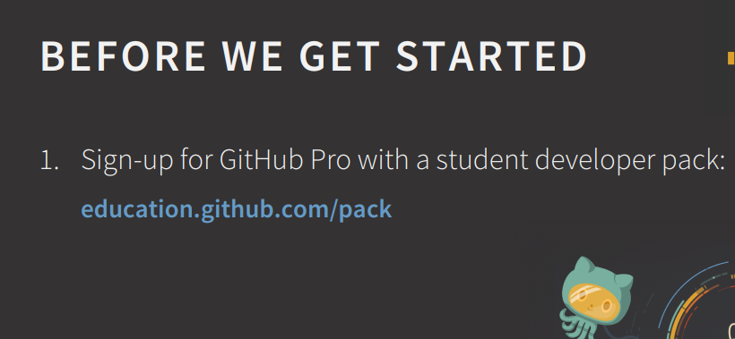

Slide 3
Objectives
Version Control
Git , Git repository
Git vs GitHub
Setup git environment
Branches and Readme.md
Create a git repository ( adding file, adding folder)
Git tools

Slide 4


Slide 5
Why Version Control?
Collaboration Versioning Rolling Back Understanding
Scenario : Multiple students are doing a project together
Question: Why not Google drive & One drive ????
source code management vs file storage management

Slide 6

Git History
Came out of Linux development community
Linus Torvalds, 2005
Initial goals:
Speed
Support for non-linear development (thousands of parallel branches)
Fully distributed
Able to handle large projects like Linux efficiently
Global Information Tracker (acronym name)

Slide 7

What is Github?
GitHub was developed by Chris Wanstrath, P. J. Hyett, Tom Preston-Werner and Scott Chacon using Ruby on Rails, and started in February 2008
It is a subsidiary of Microsoft, which acquired the company in 2018 for $7.5 billion
GitHub.com is a site for online storage of Git repositories.
You can get free space for open source projects or you can pay for private projects.
Question: Do I have to use Github in order to use Git?
Answer: No!
you can use Git completely locally for your own purposes, or
you or someone else could set up a server to share files, or
you could share a repo with users on the same file system.

Slide 8
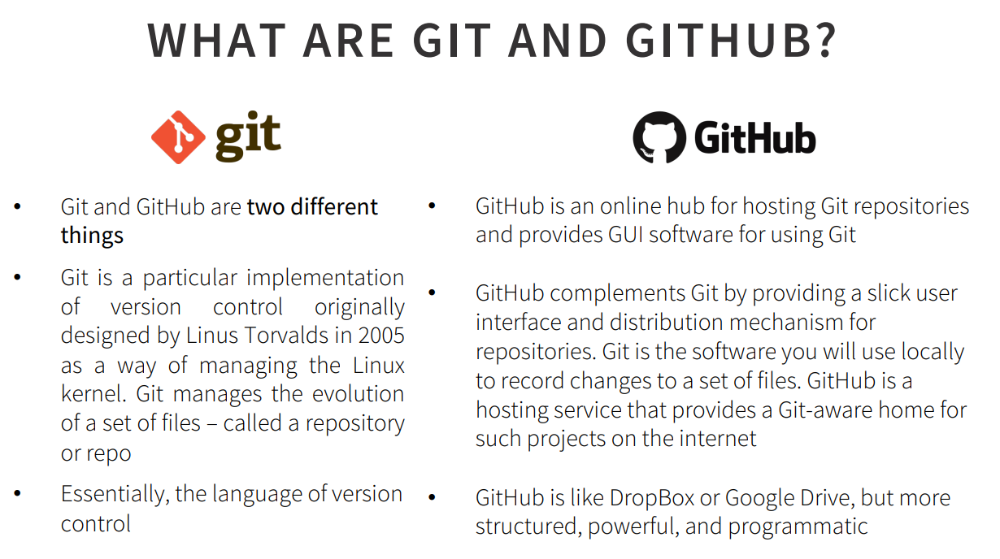

Slide 9
Git Command
command | description
git clone url [dir] | copy a git repository so you can add to it
git add files | adds file contents to the staging area
git commit | records a snapshot of the staging area
git status | view the status of your files in the working directory and staging area
git diff | shows diff of what is staged and what is modified but unstaged
git help [command] | get help info about a particular command
git pull | fetch from a remote repo and try to merge into the current branch
git push | push your new branches and data to a remote repository
others: init, reset, branch, checkout, merge, log, tag

Slide 10
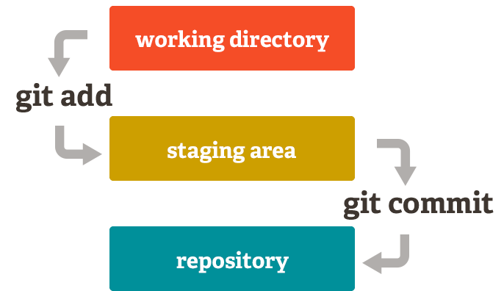
Adding a file to git repository

Slide 11
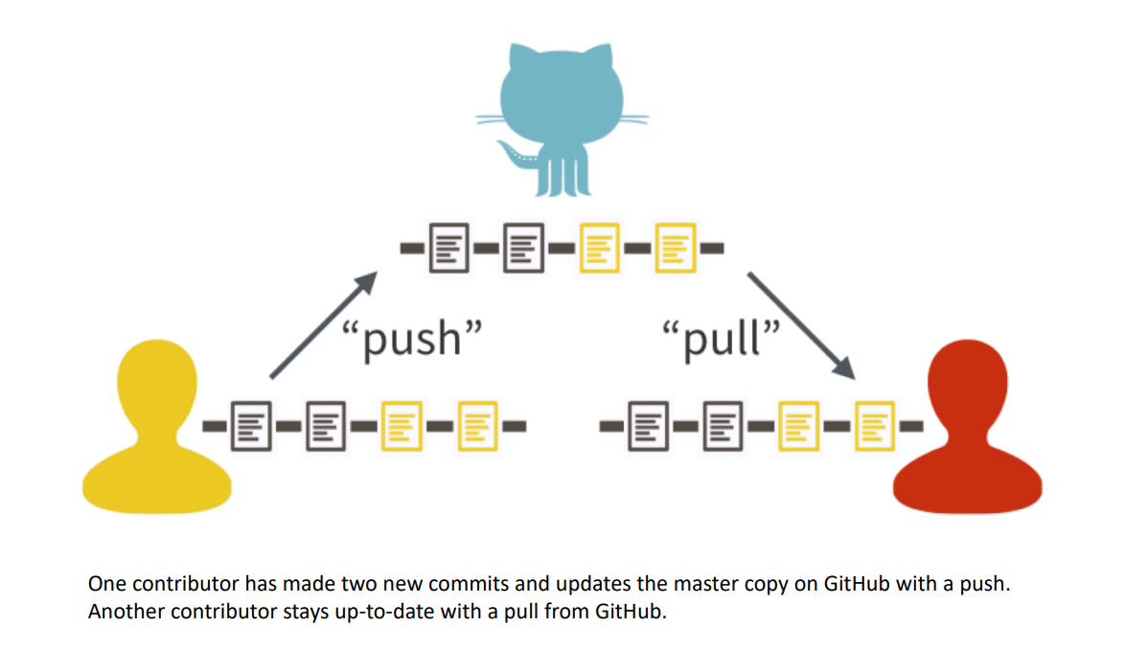
GitHub Workflow

Slide 12
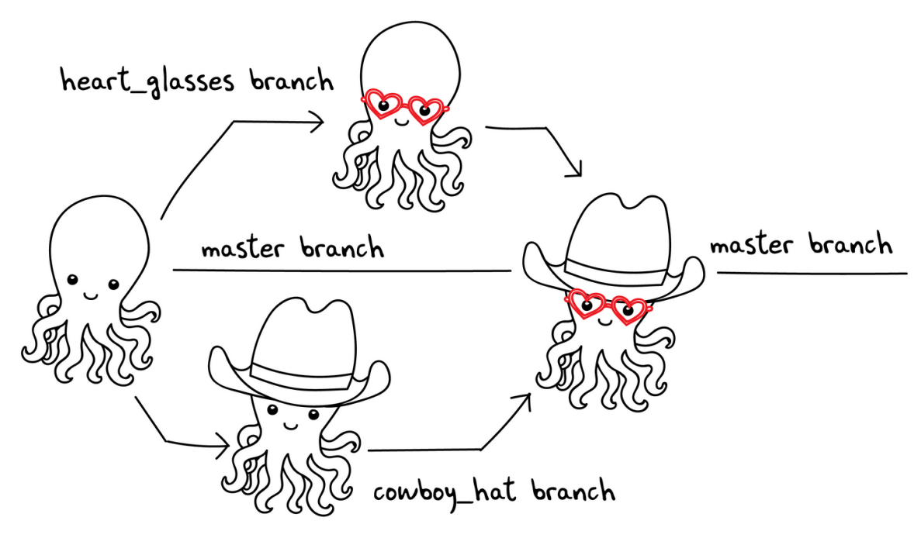

Slide 13
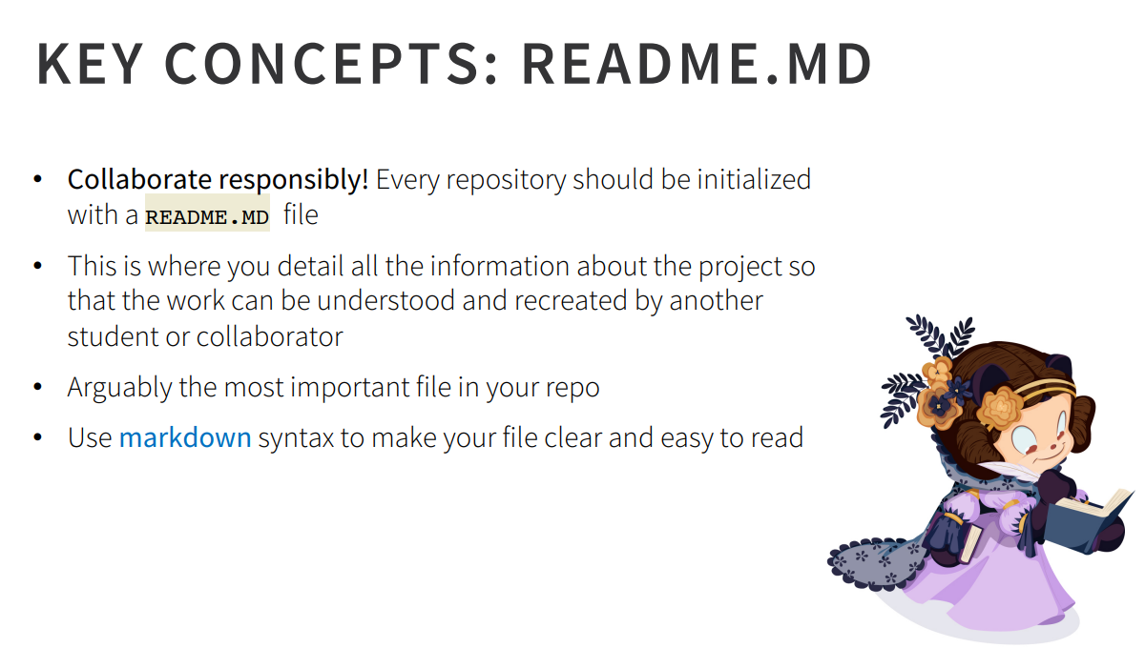

Slide 14
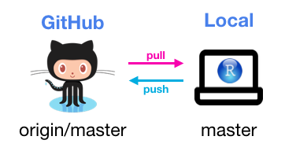
Thank You

